Slide 1
Modern Graphics Hardware
Motherboard contains CPU (multiple cores)
Graphics card is add-in board with GPU (thousands of cores)
Hardware Acceleration (GPU Rendering)
Use of dedicated processing hardware using buffer caching and modern graphics APIs for Realtime interactive visualization of graphics data
Graphics processing unit (GPU) is specifically designed to accelerate computer graphics workloads thru high-speed, parallel mathematical calculations
Accelerates rendering of 3D graphics for
interesting visual effects
realistic scenes
advanced lighting
shadowing techniques.
Now also used to accelerate additional workloads in
high performance computing (HPC)
deep learning

Slide 2
Modern Graphics Hardware
GPU Types
Integrated
Does not come on its own separate card
and is instead embedded alongside CPU
Discrete
Distinct chip that is mounted on its own
circuit board
Typically attached to a PCI Express slot.

Slide 3
Modern Graphics Hardware
CPU On-Board Facilities
3D graphics, is a calculation intensive environment.
The calculations are usually simple and can be performed in integer math
Graphics coprocessors often rely on the main CPU for performing this basic arithmetic.
Special purpose graphics processing units (GPUs)
Hundreds of processors for parallelly executing graphics algorithms more quickly
Workload sufficiency
Processes thousands of floating point operations per pixel
Strong market demand

Slide 4
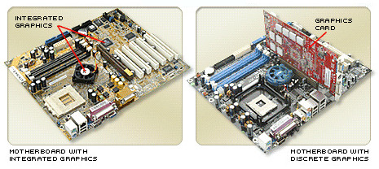
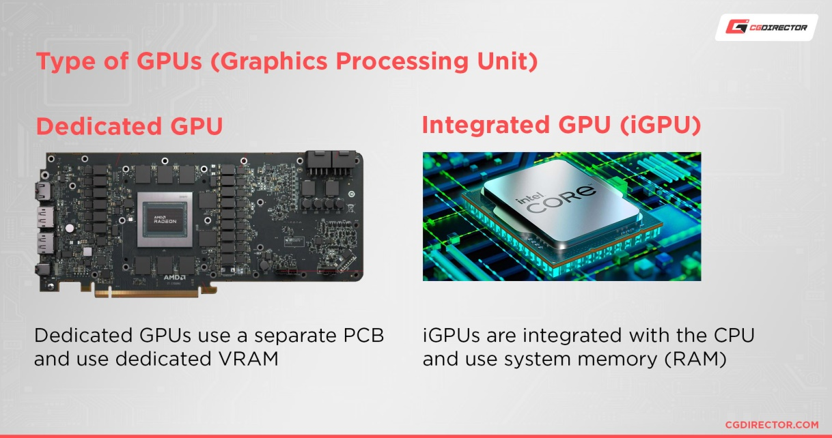

Slide 5
CPU/GPU
CPU used to perform computations necessary for rendering of graphical data which makes rendering slow
GPU is used nowadays that performs graphics
intensive calculations very quickly and in parallel
for fast and smooth rendering of graphical contents
GPU frees CPU of graphics intensive tasks

Slide 6
GPU Working Mechanism
Parallel processing, multiple processors handle separate parts of a single task.
A GPU has its own RAM designed specifically to hold large amounts of information coming into the GPU
For graphics applications, CPU sends instructions to GPU for drawing graphics content on screen
The GPU executes instructions in parallel and at high speeds to display content on device
(graphics or rendering pipeline)

Slide 7
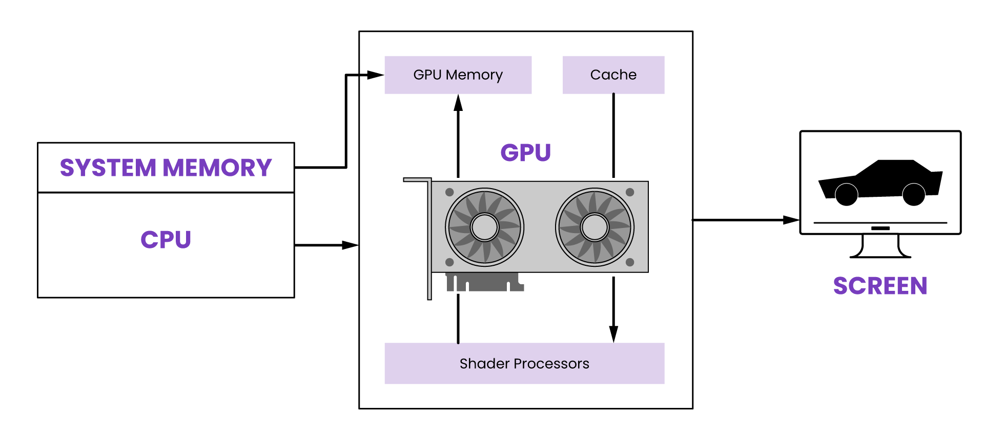

Slide 8
Uses of GPU
Accelerating the rendering of real-time 2D and 3D graphics applications.
Video editing and video content creation.
Video game graphics.
Accelerating ML applications such as image recognition and facial detection and recognition.
Training deep learning neural networks.
Mining crypto currencies e.g. bitcoin, Ethereum.

Slide 9

Cloud GPU
A virtual GPU that removes the need to deploy a GPU or associated hardware and software on a local device.
Benefits
- freeing up local resources
- saving time and cost
- greater scalability
Cloud service providers (Google, Amazon, Azure) provide cloud GPUs
A range of GPU types are available that are suitable for a variety of workloads, budgets and performance requirements.

Slide 10
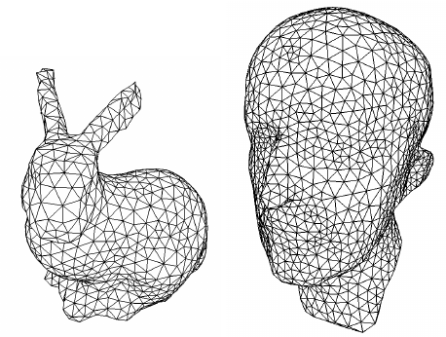
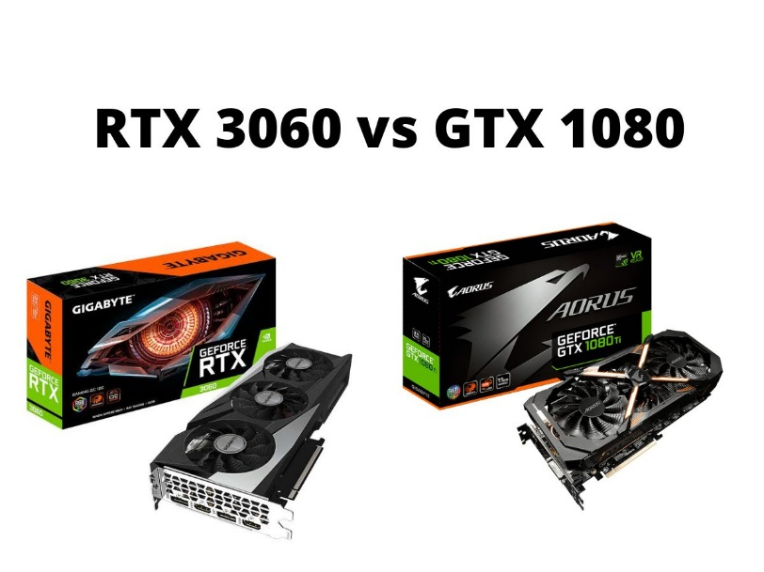
Modern Graphics Hardware
NVDIA GeForce 9800 GTX
GTX can render 340 million small triangles per second
almost 11 billion pixels per second
576 billion floating point operations per second
Chipset supports memory transfer at up to 25.6 GB/s
NVDIA GeForce 9800 GTX has 16 cores each with eight float point ALUs
GeForce GTX 1080
NVIDIA CUDA Cores: 2560
Boost Clock: 1733 MHz
Memory Size: 8 GB
GeForce RTX 3090Ti
NVIDIA CUDA Cores: 10752
Boost Clock: 1.86 GHz
Memory Size: 24 GB

Slide 11
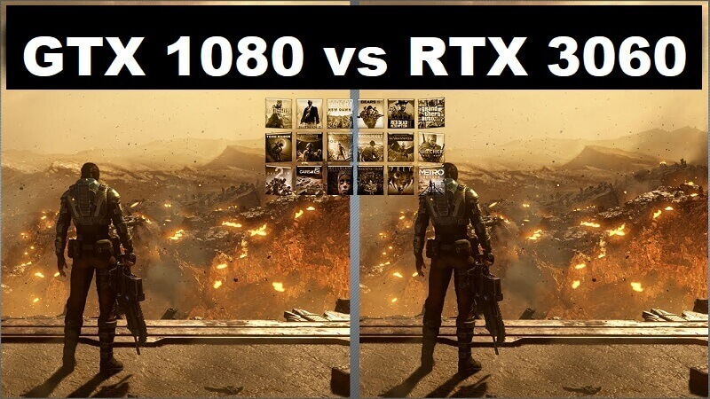

Slide 12
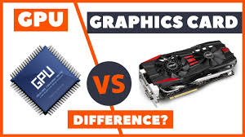
GPU vs Graphics Card difference?

